Slide 1
9. Change of Numeraire
鄭凱允

Slide 2


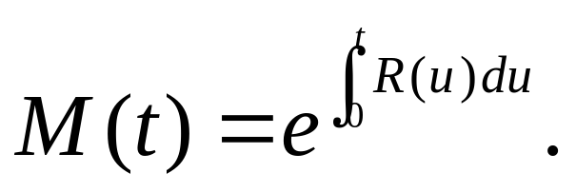
9.1 Introduction
A numeraire is the unit of account in which other assets are denominated and change the numeraire by changing to the currency of a country.
In this chapter, we will work within the d-dimensional market model by independent Brownian motion
There is an adapted interest rate process R(t) . This can be used to create a money market account whose price per share at time t is

Slide 3
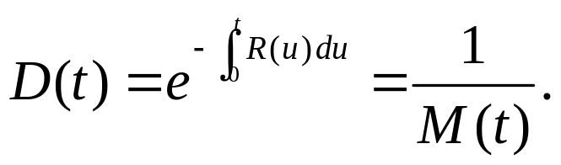
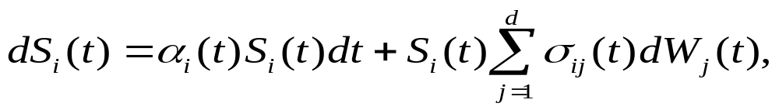




We also define the discount process
There are m primary assets in the model of this chapter, and their prices satisfy equation (5.4.6),
We assume there is a unique risk-neutral measure (i.e., there is a unique d-dimensional process satisfying the market price of risk equations (5.4.18)).
See Appendix

Slide 4
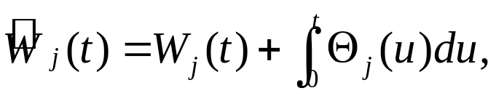



By Theorem 5.4.1, under , the Brownian motions
Are independent of one another.
Under , the discounted asset prices are martingales. if we were to denominate the ith asset in terms of the money market account, its price would be . In other words, at time t, the ith asset is worth shares of the money market account. We say the measure is risk-neutral for the money market account numeraire.

Slide 5


9.2 Numeraire
The numeraires we consider in this chapter are:
Domestic money market account associated risk-neutral measure by in section 9.1
Foreign money market account associated risk-neutral measure by in section 9.3
A zero-coupon bond maturing at time T associated risk-neutral measure by . It is called the T-forward measure and is used in Section 9,4

Slide 6
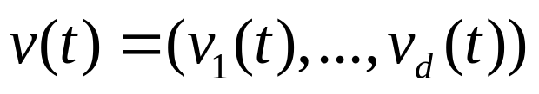


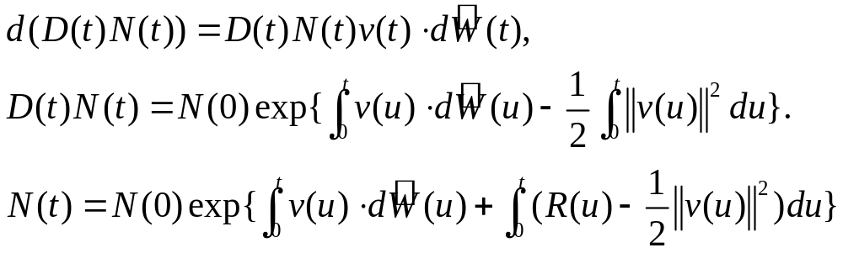
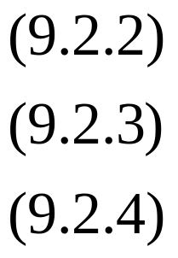
Theorem 9.2.1 (Stochastic representation of assets).
Let N be a strictly positive price process for a non-dividend-paying asset, either primary or derivative, in the multidimensional market model of Section 9.1. then there exists a vector volatility process
such that
This equation is equivalent to each of the equations

Slide 7

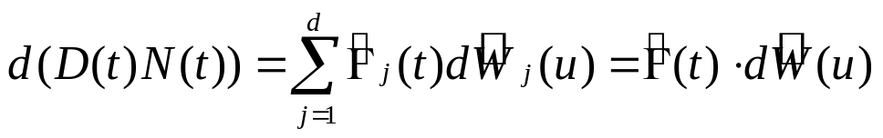


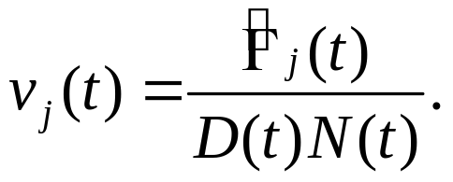
Proof: Under the risk-neutral measure , the discounted price process must be a martingale. According to the Martingale Representation Theorem, Theorem 5.4.2,
For some adapted d-dimensional process
Because N(t) is strictly positive, we can define the vector
by

Slide 8

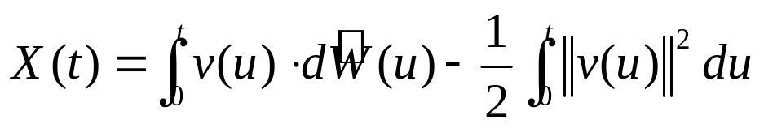
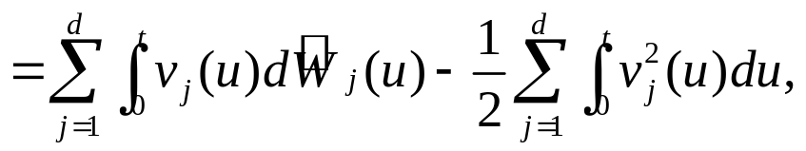
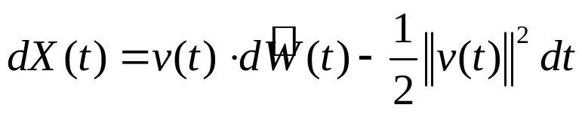
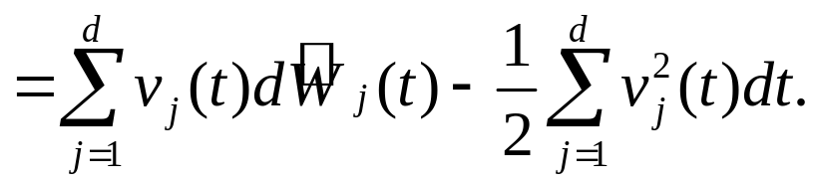
Then
which is (9.2.2).
The solution to (9.2.2) is (9.2.3), as we now show. Define
so that

Slide 9

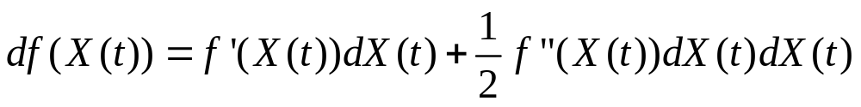
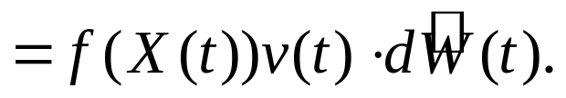
Let and complete
We see that f(X(t)) solves (9.2.2), f(X(t)) has the desired initial condition f(X(0))=N(0), and f(X(t)) is the right-hand side of (9.2.3).
Form (9.2.3), we have immediately that (9.2.4) holds. Applying the Ito-Doeblin formula to (9.2.4), we obtain (9.2.1).

Slide 10
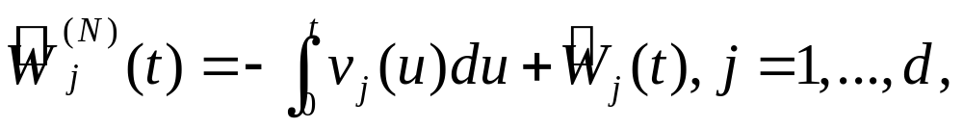

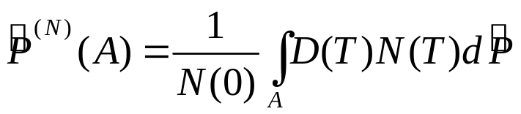


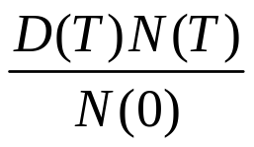




According to Theorem 5.4.1, we can use the volatility vector of N(t) to change the measure. Define
And a new probability measure
for all
We see from (9.2.3) that is the random variable Z(T)
appearing in (5.4.1) of the multidimensional Girsanov Theorem if we replace by for j = 1,…,m. here we are using the probability measure in place of in theorem 5.4.1

Slide 11



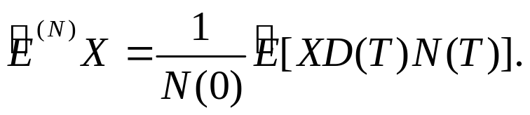

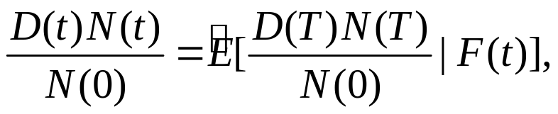

With these replacements, Theorem 5.4.1 implies that, under , the process is a d-dimensional Brownian motion. In particular, under , the Brownian motions
are independent of one another. The expected value of an arbitrary random variable X under can be computed by the formula
More generally,

Slide 12

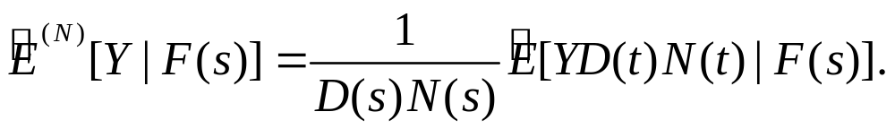

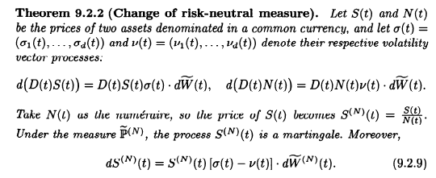
is the Radon-Nikodym derivative process Z(t) in the Theorem 5.4.1, and Lemma 5.2.2 implies that for and Y an F(t)-measurable random variable,

Slide 13

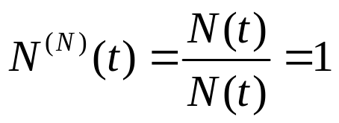
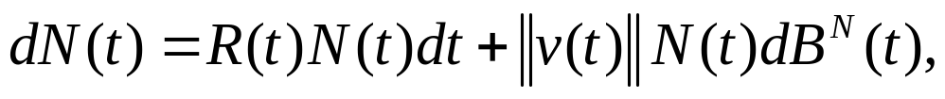

Remark 9.2.3. Equation (9.2.9) says that the volatility vector of
is the difference of the volatility vectors of S(t) and N(t). In particular, after the change of numeraire, the price of the numeraire becomes identically 1,
and this has zero volatility vector:
We are saying that volatility vectors subtract. The process N(t) in Theorem 9.2.2 has the stochastic differential representation (9.2.1), which we may rewrite as

Slide 14
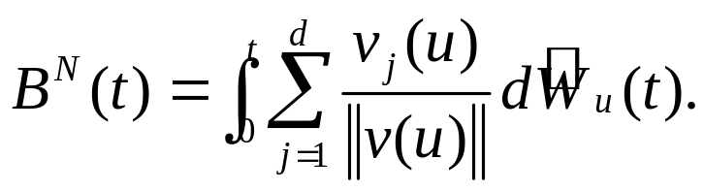






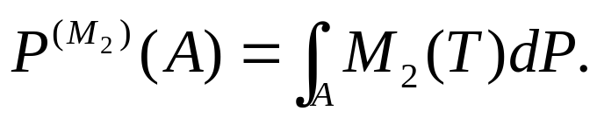
where
Remark 9.2.4. If we take the money market account as the numeraire in Theorem 9.2.2, then we have d(D(t)N(t)) = 0. the volatility vector for the money market account is v(t)=0, and the volatility vector for an asset denominated in units of money market account is the same as the volatility vector of the asset denominated in units of currency. Discounting an asset using the money market account does not affect its volatility vector.
Remark 9.2.5. Theorem 9.2.2 is a special case of a more general result. Whenever and are martingales under a measure P, , and takes only positive values, then
is a martingale under the measure defined by

Slide 15
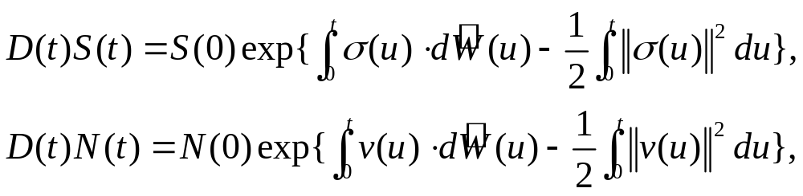
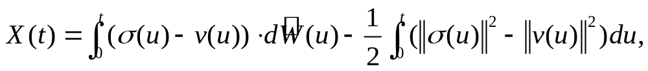
Proof of Theorem 9.2.2: we have
and hence
To apply the Ito-Doeblin formula to this, we first define

Slide 16
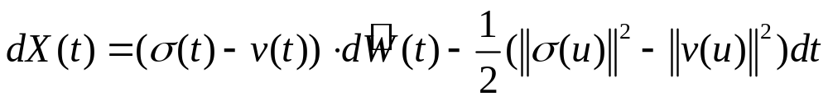
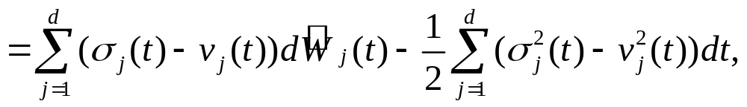
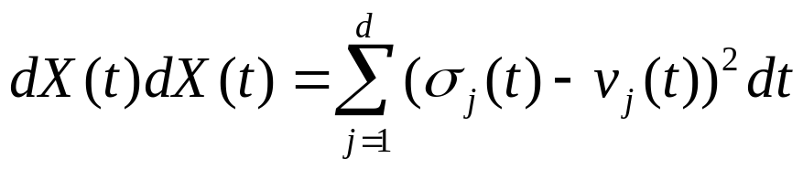
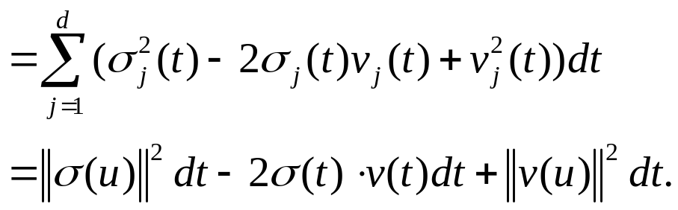
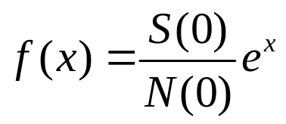

so that
With , we have and

Slide 17
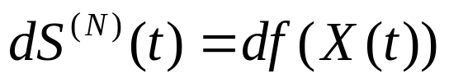
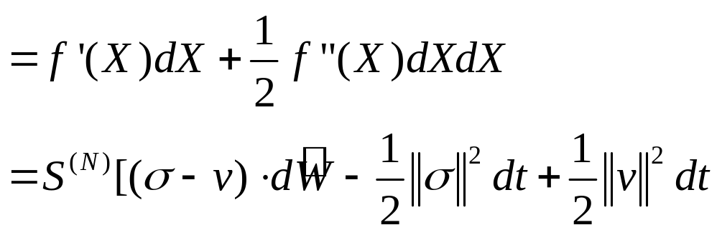
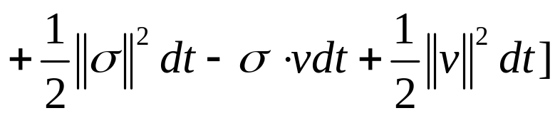
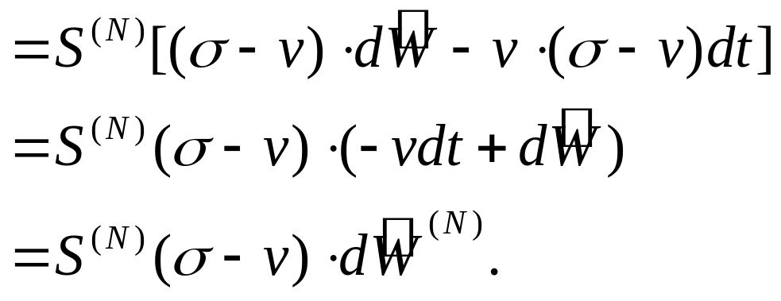


Since is a d-dimensional Brownian motion under , the process is a martingale under this measure.

Slide 18
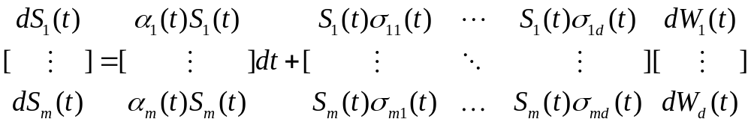

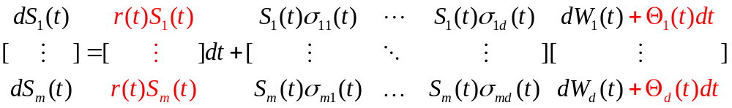
Appendix
Use matrix to extensive (9.1.1)
In order to make risk-free return, we plus with diffusion term.
so that we find satisfying (5.4.18)

